Slide 1


Uber Data Analysis: A Deep Dive into Mobility Trends
This project delves into the vast dataset of Uber rides, exploring the patterns, trends, and insights that shape the mobility landscape. We'll utilize powerful data science tools and techniques to unravel the intricacies of this dynamic industry.

Slide 2

TEAM MEMBERS
Ganjam Hairtha Maithreyee – 2110030014
Devineedi Neha – 2110030032
Gunde Mahitha Christina – 2110030147
Nitish Kumar - 2110030121

Slide 3
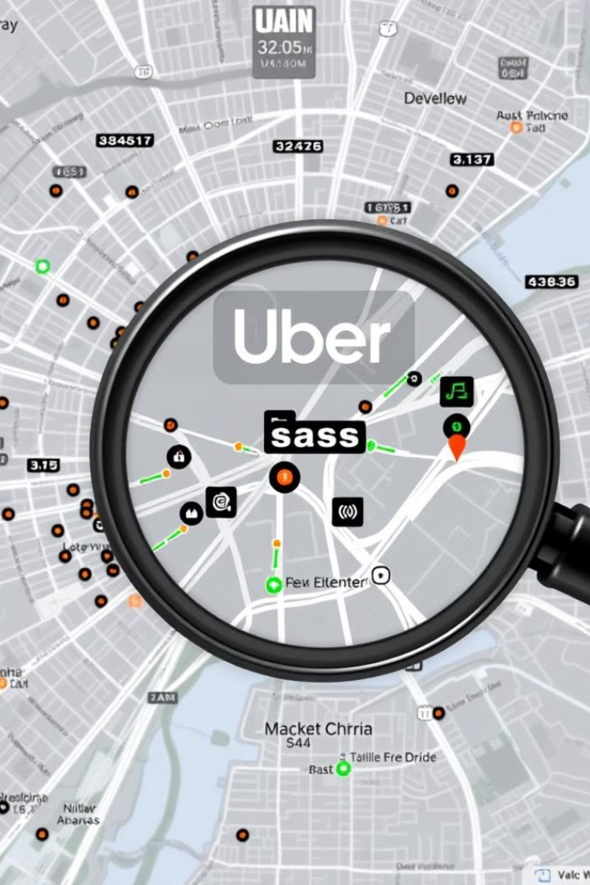
Objectives of the Project
1
Ride Demand Analysis
2
Pricing Dynamics
Analyze the relationship between surge pricing, time of day, and ride distance, revealing the pricing mechanisms.
Investigate the factors influencing ride demand across different times, locations, and days of the week.
3
User Behavior
4
Operational Efficiency
Understand user preferences, ride frequency, and travel patterns, uncovering insights into customer demographics.
Explore ride allocation strategies and driver utilization, identifying areas for optimization and improvement.

Slide 4
Proposed Methodology
Data Acquisition and Cleaning
1
Gather and cleanse the Uber dataset, removing inconsistencies and preparing it for analysis.
2
Exploratory Data Analysis
Visualize and analyze the data, uncovering initial trends and insights through data exploration.
Feature Engineering
3
Create new features, including time-based metrics, location-based features, and ride characteristics, to enhance model accuracy.
4
Model Building and Evaluation
Employ machine learning algorithms to build predictive models, such as forecasting ride demand or identifying surge pricing patterns.
Results Interpretation and Visualization
5
Interpret the model results and present actionable insights through visualizations, reports, and dashboards.

Slide 5
Implementation Details
Data Preparation
Modeling
Visualization
Utilize NumPy and Pandas for data loading, manipulation, and transformation.
Employ Scikit-learn for building machine learning models, including regression and classification techniques.
Leverage Matplotlib and Seaborn for creating insightful data visualizations, including charts and graphs.

Slide 6

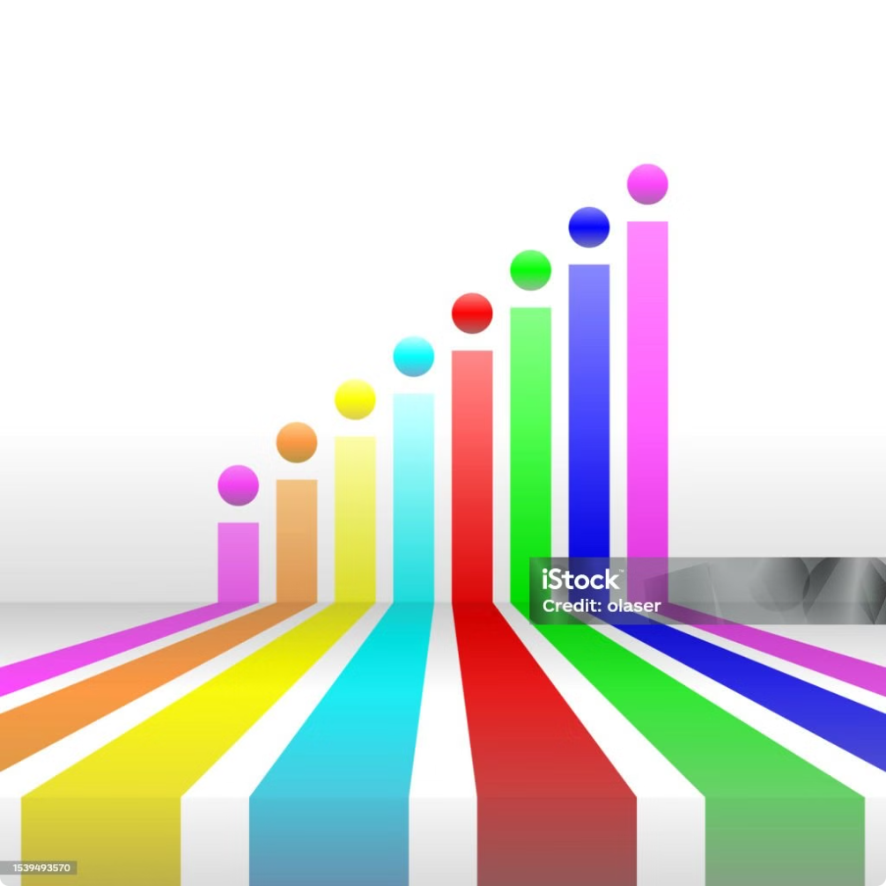
Results
Peak Ride Demand
Surge Pricing Patterns
Identified peak hours for ride demand, particularly during rush hours and weekends.
Revealed a strong correlation between surge pricing and peak demand, with higher prices during congested periods.
User Behavior Trends
Observed variations in user behavior, including ride frequency and preferred ride types, based on location and time.

Slide 7
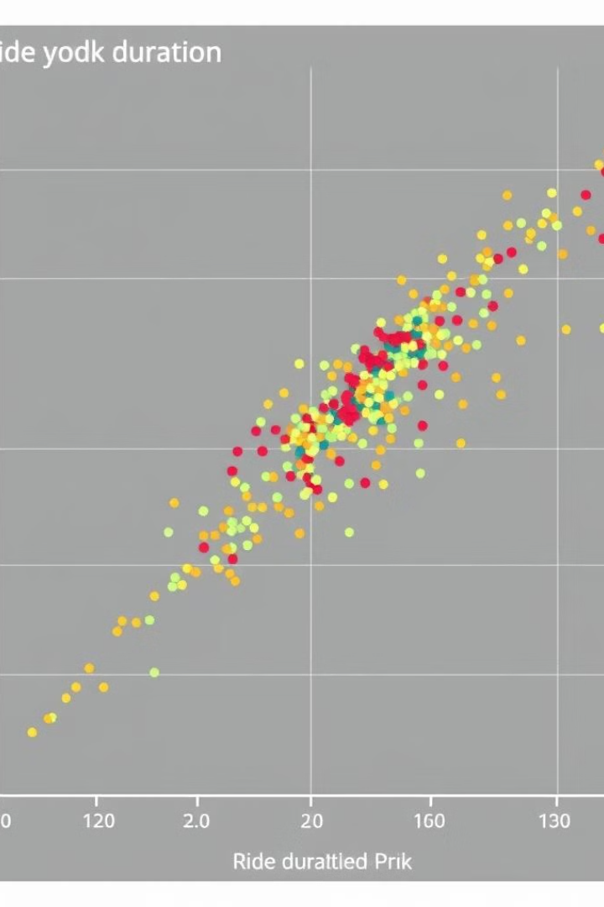
Data Preprocessing and Exploratory Data Analysis
Data Cleaning
Handling missing values, removing duplicates, and ensuring data consistency.
Data Transformation
Converting categorical features into numerical representations for model compatibility.
Data Exploration
Analyzing ride count, duration, distance, and pricing patterns across various time periods and locations.

Slide 8
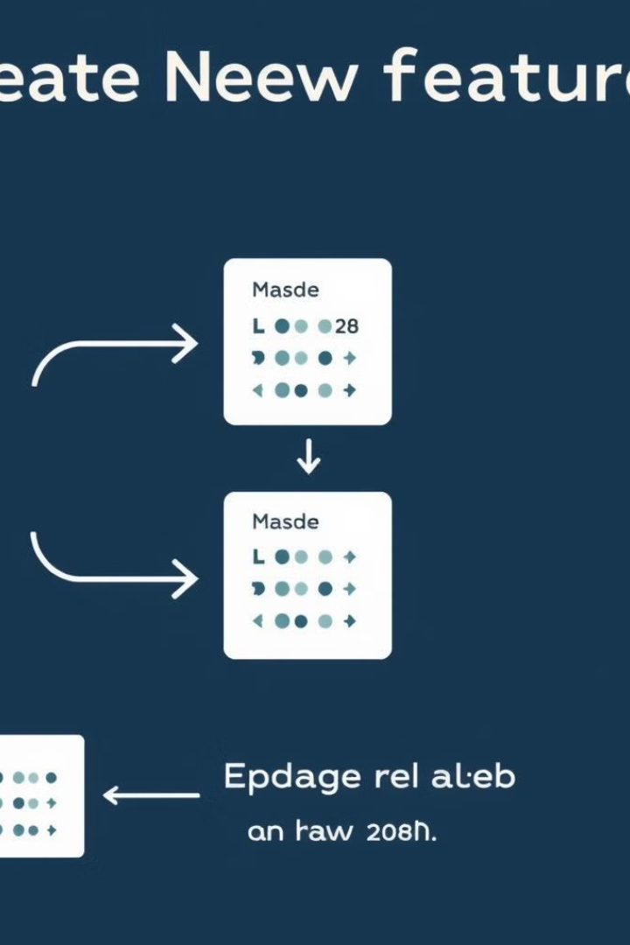



Feature Engineering and Selection
Time-Based Features
Extracting features like day of the week, hour of the day, and time of day to capture temporal patterns.
Location-Based Features
Creating features such as distance from landmarks, proximity to major hubs, and population density.
Ride Characteristics
Engineering features like ride distance, duration, and fare amount to reflect ride characteristics.

Slide 9
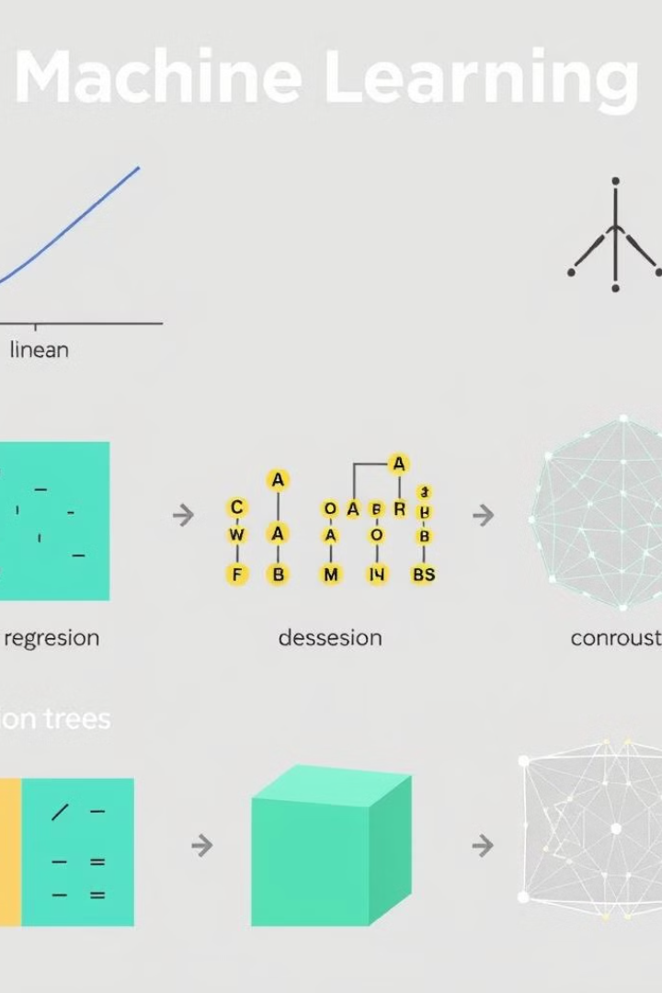




Model Building and Evaluation
Linear Regression
Decision Trees
Predicting ride demand or surge pricing using linear relationships between features and target variables.
Creating a tree-based model to classify rides based on features and predict potential outcomes.
Neural Networks
Model Evaluation
Building complex models to capture non-linear relationships and enhance prediction accuracy.
Assessing the performance of trained models using metrics like accuracy, precision, recall, and F1-score.

Slide 10
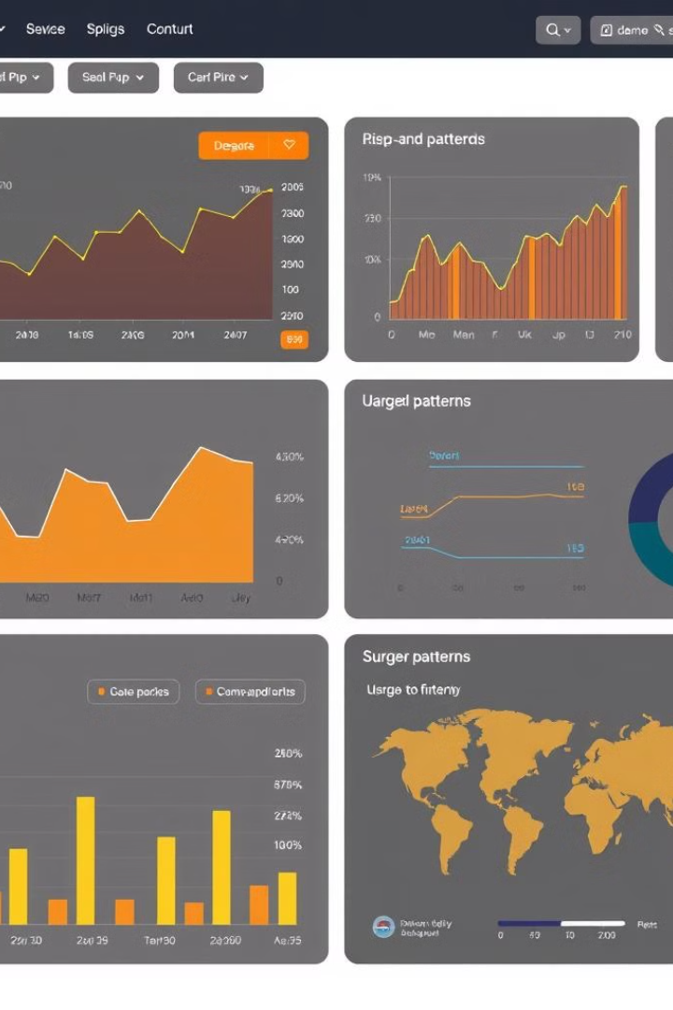
Insights and Recommendations
The project delivers valuable insights into the factors influencing Uber ride demand, pricing dynamics, and user behavior. This knowledge can be utilized by Uber to optimize pricing strategies, enhance user experience, and improve operational efficiency.

Slide 11

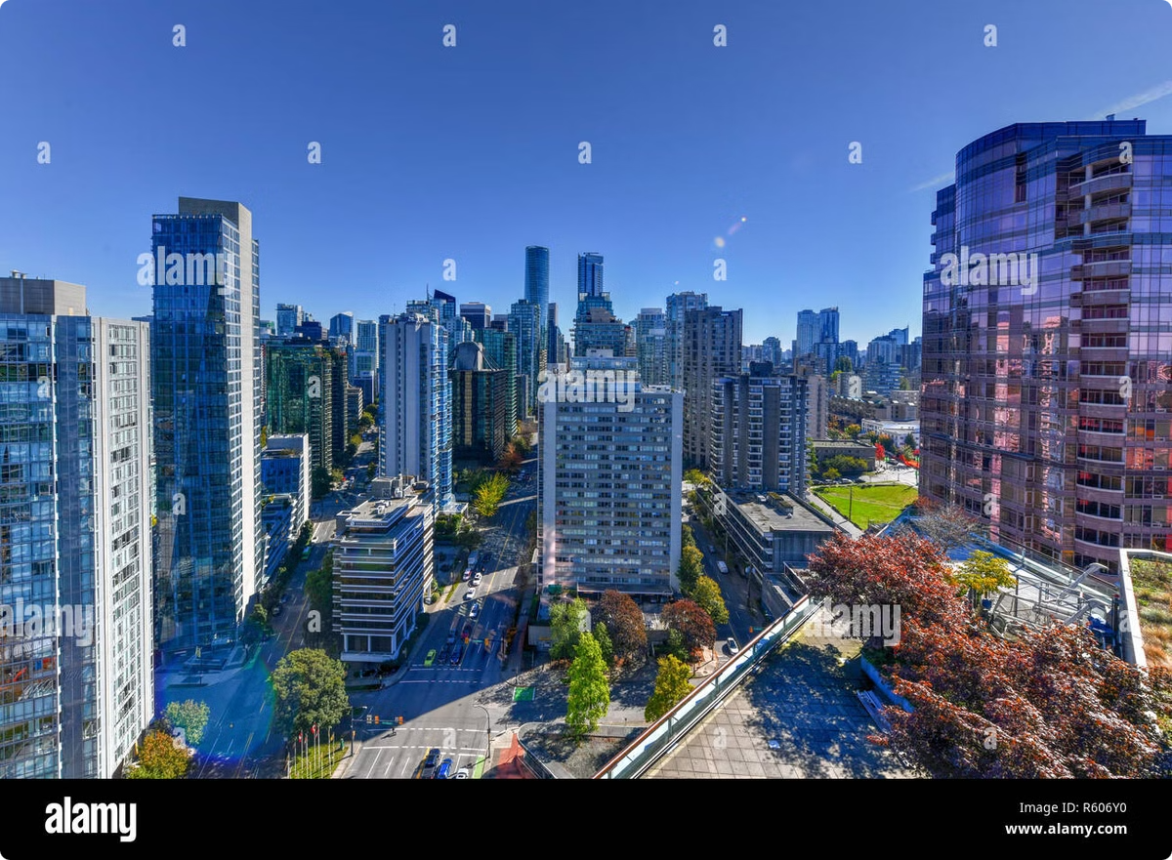
References
https://www.kaggle.com/code/datalearn/uber-data-analysis-machine-learning
https://codebasics.io/blog/how-uber-uses-data-analytics-to-increase-supply-efficiency
https://www.kaggle.com/datasets/bhanupratapbiswas/uber-data-analysis​
https://phdservices.org/uber-data-analysis-project-using-machine-learning/

Slide 12


